Slide 1
Web Accessibility
An Evaluation and Discussion of the Web Accessibility of Academic Library Web Sites

Slide 2
Introduction
Dave Comeaux, Web Services Librarian at Tulane University
Co-Authored a 2006 research paper studying web site accessibility
Finishing up a follow-up study (research conducted in 2010)
For this presentation, I analyzed the accessibility of 4-year academic libraries In Louisiana

Slide 3
What is Web Accessibility
Why it’s Important
How Academic Libraries are doing
Notes:
Hi everyone,
I’m going to start by defining web accessibility, then I’m going to talk about why it matters. The bulk of my presentation will be discussing my research into how library web sites account for accessibility.

Slide 4
What is web accessibility?
Web accessibility means that people with disabilities can use the Web. More specifically, Web accessibility means that people with disabilities can perceive, understand, navigate, and interact with the Web, and that they can contribute to the Web. (World Wide Web Consortium - http://www.w3.org/WAI/intro/accessibility.php)
Web accessibility refers to the inclusive practice of making websites usable by people of all abilities and disabilities. When sites are correctly designed, developed and edited, all users can have equal access to information and functionality. (Wikipedia - http://en.wikipedia.org/wiki/Web_accessibility)
Notes:
Here are a couple of definitions. When “Accessibility” is discussed in reference to libraries, it can mean different things, depending on the context. Sometimes accessibility refers to making resources available to a variety of patrons. It also refers to making physical accommodations for patrons with disabilities.
But “web accessibility” usually means designing your web sites to be easy to use by patrons with disabilities.

Slide 5
Types of Disabilities
Visual Blindness, low vision, color-blindness
Hearing Deafness
Motor Inability to use a mouse, slow response time, limited fine motor control
Cognitive Learning disabilities, distractibility, inability to remember or focus on large amounts of information
Notes:
There are 4 main types of disabilities.
Visual disabilities refer to blindness, low vision and color blindness. Because the World Wide Web has developed into primarily a visual medium, it’s easy to forget that a wide variety of audio content is potentially available on the internet. Also, screen reading programs, which I’ll talk about in some detail later, open up a world of content to the visually disabled.
Audio disabilities refer to varying degrees of deafness.
Motor disabilities
Many of us take the use of a mouse for granted, and struggle to do even basic tasks without one. But patrons with partial paralysis have no choice but to navigate by keyboard only. Common design features such as drop-down menus can be completely inaccessible to
Cognitive disabilities are sometimes thought of as “hidden” disabilities, but these are actually the most common types of disabilities. The good news is that many of the same design principles that make web sites easier to use also benefit patrons with learning disabilities. Some of these include having a consistent layout, use of words and symbols consistently and using clear, jargon-free language.

Slide 6
Why is it important
Helps everyone
Required by law
Helps fulfill the long-standing goal of libraries to provide barrier-free access to everyone
Notes:
I’ll spend the next few minutes discussing why web accessibility is an important thing to consider.
First, most accessibility practices help a web site’s usability for all patrons.
Also, there are laws that apply to many institutions.
Finally, libraries typically pride themselves on providing access to information.

Slide 7
Helps Everyone
Accessible design is universal design
Each of the major categories of disabilities requires certain types of adaptations in the design of the web content. Most of the time, these adaptations benefit nearly everyone, not just people with disabilities.
For example:
Almost everyone benefits from helpful illustrations, properly-organized content and clear navigation.
Similarly, while captions are a necessity for Deaf users, they can be helpful to others, including anyone who views a video without audio.
(WebAIM - http://webaim.org/intro/)
Notes:
The adaptations that should be made to help disabled patrons also help everyone. For example, providing consistent layouts and logical navigation are especially helpful for learning disabled patrons, but also make things easier for anyone using the site. Providing captions, or text equivalents for audio content, help those who don’t have audio enabled, or don’t want to put on headphones or disturb others by listening to audio. Also some users disable images and flash content to minimize download time, so alt tags help these users also.

Slide 8
Legal Mandate for Accessible Web Content
Sect. 508 (Rehabilitation Act Amendment of 1998) Under Section 508 (29 U.S.C. ‘794 d), agencies must give disabled employees and members of the public access to information that is comparable to access available to others.
Section 504 (Rehabilitation Act of 1973)
ADA (1990/2008)
Title II (public entities)
Title III (private entities; places of public accommodations)

Slide 9
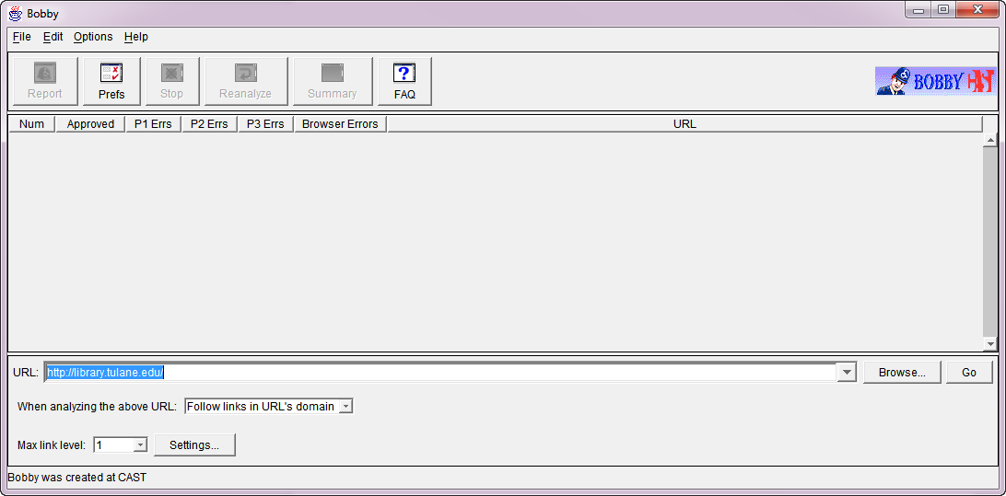
Research Methodology
2010 Study of 56 North American Libraries
Automated accessibility checker: Bobby 3.1.1 W3C-WCAG, Priority 1, compliance check.

Slide 10
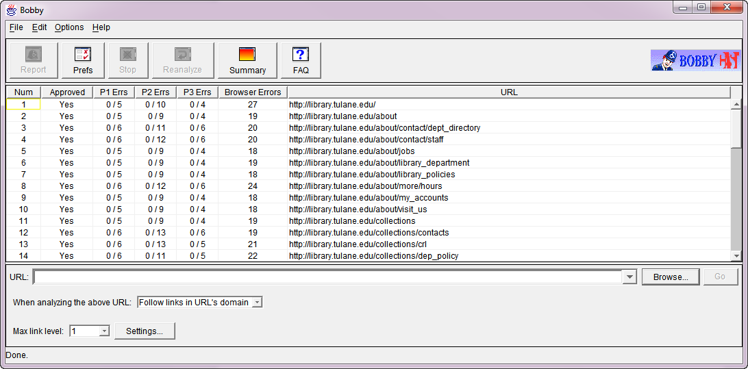
Research Methodology
2010 Study of 56 North American Libraries
Automated accessibility checker: Bobby 3.1.1 W3C-WCAG, Priority 1, compliance check.

Slide 11
Research Methodology
2010 Study of 56 North American Libraries
Manual testing for "skip nav" link, a Section 508 requirement (2006 & 2010 only)
Additional variables
Methods used for page lay-out (tables v. divs; 2010)
CMS (yes or no; 2010)
Scope: homepages plus one link-layer down (within the domain)
Study size:
all 56 ALA-accredited SLISs and the main libraries at these institutions (2002, 2006, 2010)
Geographic coverage: US and Canada

Slide 12
Research Methodology
2011 Study of 22 Louisiana Libraries
Web Sites studied:
22 Louisiana 4-year colleges & universities

Slide 13
Research Questions
How accessible are the library Web sites?
(in terms of the percentage of barrier-free pages)
2. How many library sites use "Skip Navigation" links and does their use correlate with accessibility?
5. How does the method of page layout (table-based or div-based) correlate with accessibility?
6. Does the use of a Content Management System (CMS) correlate with accessibility?

Slide 14
How accessible are they?
56 North American Libraries
How accessible are the major library Web sites on the campuses with SLIS schools in 2010?
Overall, 61% Bobby-approved.
8 were 100% approved.
13 sites were above 90% approved.
11 were between 80% & 90% approved.
6 had no approved pages
7 had less than 10% approved.

Slide 15
How accessible are they?
22 Louisiana Libraries
How accessible are the library Web sites on the Louisiana campuses in 2011?
Overall, 57% Bobby-approved.
7 were 100% approved.
4 sites were between 90% and 100% approved.
11 were between 80% & 90% approved.
4 had no approved pages
4 had between 1% and 10% approved.

Slide 16
Skip Navigation
Why have Skip Navigation links?

Slide 17
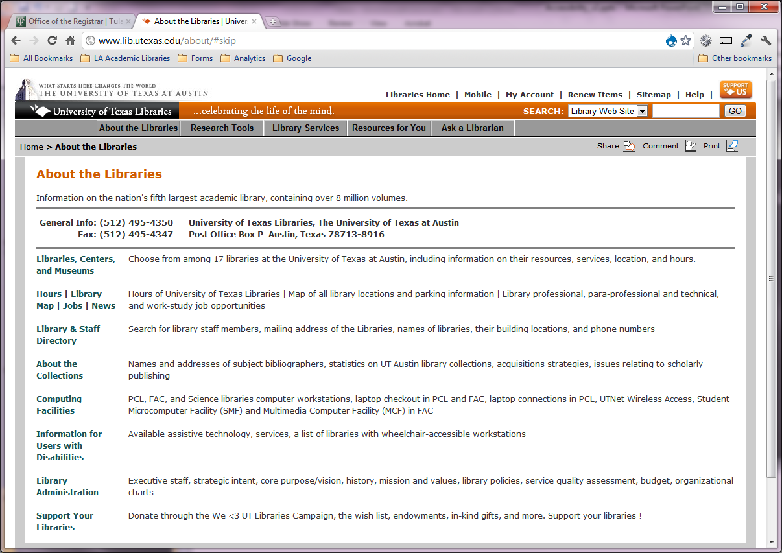
Skip Navigation
Why have Skip Navigation links?

Slide 18
How many library sites use "Skip Navigation" links?
56 North American Libraries
25 (44.6%) used skip navigation links.
22 Louisiana Libraries
5 (22.7%) used skip navigation links.

Slide 19
Connection between use of “skip links” and broader accessibility
North American Library Sites
 | With Skip Links | Without Skip Links
% Approved | 65.92% | 56.48%
Louisiana Library Sites
 | With Skip Links | Without Skip Links
% Approved | 92.00% | 44.92%

Slide 20
Impact of Page Layout
How does the method of page layout (table-based or CSS-based) correlate with accessibility?
Notes:
This question explores whether there is a correlation between how sites are laid out and their accessibility. My interest in this question was sparked by my observation that a large number of the missing alt tags were associated with spacer images used in tables.
When web design was in its infancy, pages consisted mainly of lists of links with little structure. Soon, designers learned to manipulate HTML tables to give them some measure of design flexibility. However, tables can be tricky to use as a design mechanism, as they were never intended for this purpose. Therefore, designers often resorted to inserting precisely-sized images in table cells to force pages to display as intended. Since these images do not convey meaning, it is understandable that designers would neglect to include alt tags. However, screen readers read them and are a significant annoyance to screen reader users.
With the introduction of Cascading Style Sheets, level 2 (CSS2) in 1998, designers were afforded a new toolset for structuring pages. CSS2 includes a visual formatting model known as the “Box model.” Block-level elements, such as the<div>, <p> and <ul> elements, could be given properties such as height, width, and a variety of visual characteristics that made them more effective as page design elements. Block-level elements, primarily the <div> element, became an alternative means of structuring web pages. With a div-based layout, spacer images were no longer necessary to force HTML tables to bend to the will of a designer’s vision.

Slide 21
Impact of Page Layout
For example:
Notes:
Here an example of what a screen reader would sound like on a page built mainly with tables…

Slide 22
Impact of Page Layout
By all measures, these sites exhibited significantly higher accessibility barriers.
 | Table-based | CSS-based
% Approved (NA) | 42.11% | 64.26%
% Approved (LA) | 9.00% * | 59.24%
* Only one site
Notes:
The numbers indicate a substantial correlation between the use of div-based layouts compared to table-based layouts.

Slide 23
Does the use of a (CMS) correlate with accessibility?
Does the use of a Content Management System (CMS) correlate with accessibility?

Slide 24
What is a Content Management System?
What is a Content Management System, anyway?
A Content Management System (CMS) is a web-based software application that uses a programming language to assemble web pages from content stored in a database.
Pages are built according to a template, which in theory can make accessibility easier

Slide 25
How many sites use a CMS?
56 North American Libraries
14 (25%) used a CMS.
22 Louisiana Libraries
5 (22.3%) use a CMS.

Slide 26
Are they more accessible?
Dramatically!
 | CMS | Not CMS
% Approved (NA) | 71% | 57%
% Approved (LA) | 59.83% | 49.94%

Slide 27
Conclusions
The use of “skip navigation” links are associated with higher accessibility
Building your web site with CSS improves accessibility
Using a CMS for your web site improves accessibility

Slide 28
Recommendations
Contact the Disability Services office at your university to determine how many disabled students, (of each type) you have
Explain that you are eager to help ensure that resources are accessible
Broaden your accessibility policies to include web accessibility

Slide 29
Recommendations
Use a CMS, or at least a CSS-based layout for your next redesign
Label all images with a descriptive alt tag (for images that convey information), or a null tag e.g., alt=“”, for images that are merely decorative
Notes:
If you’re planning a redesign, consider using a CMS, (such as Drupal) for your web site.
If not, try

Slide 30
Testing your sites
Web Developer Toolbar

Slide 31
Testing your sites
Functional Accessibility Evaluator 1.1
http://fae.cita.uiuc.edu/about/

Slide 32
Questions?

