Slide 1
User Testing of Primo at Tulane
What do our students think of
Web Scale Discovery?
Notes:
Welcome and thanks for coming!

Slide 2
About Us
Dave Comeaux
Web Services Librarian
User Testing Committee Chair
Certified Usability Analyst (HFI)
Kate Montgomery
Electronic Resource Management
User Testing Committee Member
Notes:
I was the lead of the usability project, Kate was a member

Slide 3
User Testing of Primo at Tulane
Studies show that undergraduates often employ simple search strategies. This has led to the assumption that today’s students expect a “Google-like” search.
Does user testing support this conclusion?
Notes:
Studies show that undergraduates often employ simple search strategies. This has led to the assumption that today’s students expect a “Google-like” search. Does user testing support this conclusion?

Slide 4
The Implementation
Implemented Primo (with Primo Central) simultaneously with switching to a hosted environment with Voyager, MetaLib and SFX, all between June and August!
This tight deadline hampered our marketing and training efforts, and prevented us from conducting usability testing prior to launch (no system to test)
Notes:
We

Slide 5
The Implementation
Implementation Committee was formed to manage this multi-faceted project (Public Services, Tech Services, and IT)
Subcommittees were formed to tackle specific aspects, such as Marketing, Training, Voyager Migration, SFX Migration, and a User Assessment subcommittee

Slide 6
The Implementation
Compromise: looks like single search, but acts like a tabbed search

Slide 7
User Testing Overview
User Assessment Sub-Committee employed three methods:
Data Collection (compared statistics, e.g. searches, circ, ILL, downloads, before and after)
Survey (Survey Monkey, published on web site)
Usability Testing

Slide 8
Data Collection
Overall searches have increased
 | Fall 2010 | Fall 2011 | % Change
Voyager | 312,180 | 188,494 | -65.7
Metalib | 260,975 | 163,517 | -59.7
Primo | 0 | 497,245
Total | 573,155 | 849,256 | +32.5

Slide 9
Data Collection
Full-text downloads have increased
 | Fall 2010 | Fall 2011 | % Increase
Downloads | 367,831 | 394,099 | 6.7
Digital Collections usage spiked by 50%

Slide 10
Survey
Survey was published on our web site for several weeks
Seven questions, including an open-ended comments field
Received 224 responses

Slide 11
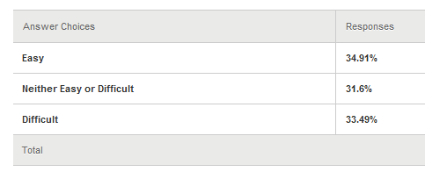
Survey
How would you rate SearchAll’s Usability

Slide 12
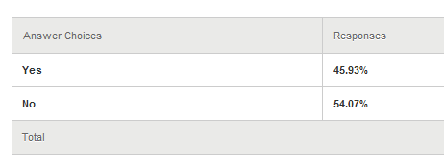
Survey
Were you satisfied with your search results?

Slide 13
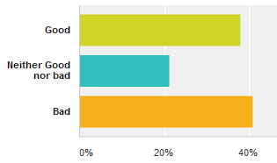
Survey
How would you rate your overall experience with SearchAll?
Good | 37.98%
Neither Good nor bad | 21.15%
Bad | 40.87%

Slide 14
Survey
The Good…
A well-constructed search engine that allows intuitive yet intensive quick searches…
I like to define limits to my research
Helpful!
It's great!
Search all is amazing!! I can't believe how far we've come in our ability to efficiently handle large amounts of information, and search all is a great example of a tool that makes it easy to sift through tons and tons of articles
12 responses were positive

Slide 15
Survey
The Bad…
Often when I search for a specific book, I get reviews of the book first and can have trouble finding the actual book! (3 comments about book reviews or articles)
Brings up too much information! Please go back to how it was; it was fine.
Having everything together looks cluttered and hinders the research process. I usually am looking either specifically for a book OR an article, so the search all option is useless and nonessential.
22 responses were negative because of “information overload” or irrelevant results

Slide 16
Survey
The Bad…
I am a senior at Tulane….The previous format was perfectly fine- I found what I wanted where I wanted. On top of that, now there are errors in the links, so when I do finally find the article I want, I can't be connected to the online full text.
At least half of the links that I've tried to view articles online do not work properly. It is very frustrating to find information with the service.
Tabs have errors opening meaning I cannot get access to papers.
22 negative comments referred to technical issues

Slide 17
Survey
Conclusions:
Marketing and outreach is important
If you change your interface radically, you’ll get negative feedback
Expect negative comments from both students and faculty
Complete Survey Data is available on Google Docs

Slide 18
Usability Testing
Participants included:
11 undergraduates (diverse majors)
4 graduate students
5 faculty members
Patrons were encourage to “talk out loud” and tests were recorded using Silverback (like Morae, but cheaper)
Notes:
A detailed discussion will be published in an upcoming special issue of “College and Undergraduate Libraries”.
ADD SLIDE about pre-test questions

Slide 19
Pre and Post Test
Pre Test questions:
How often have you used SearchAll?
Did you attend any workshops?
Post-test Questions
Rate usability
Rate results
Suggestions for improvement

Slide 20
Tasks
Five Tasks, designed to test:
the "facets" (the search results refinement options displayed on the screen)
the ability to access full text
the ability to make a request on an item

Slide 21
Research Questions
1: Are patrons confused by the array of formats displayed in the results? Or do patrons intuitively use the facets to select specified material types in a single set of results?
2: How quickly do patrons adjust to the facet-based search, i.e., how learnable is the system?
3: What are the major stumbling blocks that patrons encounter and what can we do to improve them?
4: How would users rate the usability of SearchAll and the quality of search results?
Notes:
These are the research questions we covered. Due to the time constraints, we’ll only cover the first two.

Slide 22
Research Question 1
Can users easily find a book or video amidst a page full of articles and/or reviews?
"However, it was obvious from observing them that they did have trouble interpreting the screen results and understanding the differences between different formats. For example, in the Library One Search results list display, students were confused between the record of a book, and the record of a book review." (Gross and Sheridan 2011)
Notes:
One potential drawback of discovery systems is the difficulty some users report when trying to find a known item (usually a book or video) amidst a page full of articles and/or reviews about the item. We see this documented in previous studies, as well as in our survey which we’ll cover shortly.

Slide 23
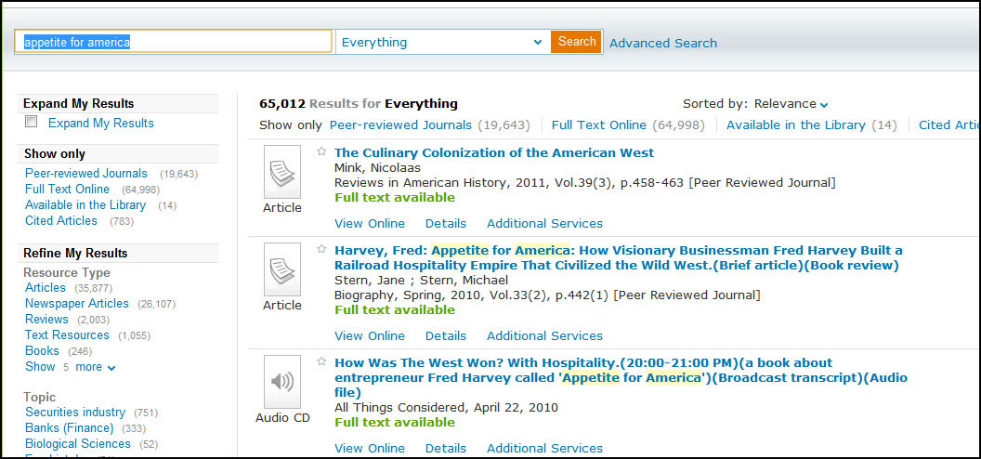
Research Question 1

Slide 24
Research Question 1
Response time (from when results page loaded until user clicked) ranged from 3 and 48 seconds, with an average of 22 seconds.
There was obvious confusion as they scanned the first page of search results
3 of the 11 undergraduate students first clicked on an article.

Slide 25
Research Question 1
Graduate students were much quicker, with one selecting the Books facet in two seconds
Faculty appeared confused. The shortest time taken was eight seconds. One struggled for a full minute

Slide 26
Research Question 1
Conclusion
results list is not intuitive
Undergraduates and faculty were confused; grad students less so
Notes:
Clearly, it’s a stretch to call the results screen intuitive
Undergraduates, (the primary intended audience) particularly struggled

Slide 27
Research Question 2
The next major question was how quickly patrons could learn the system.
We expected that the time it took each patron to select the "Books" limiter to decrease substantially from the time it took in the first question. If this would be true, we could infer that SearchAll was highly learnable.

Slide 28
Research Question 2
You are looking for books about Senate hearings on mortgages. How many books does the library have?
Notes:
Again, we asked about books

Slide 29
Research Question 2
Participants did in fact recognize the facets much more quickly for question 2.
 | Q1(s) | Q2(s) | % Reduction
Undergraduates | 22.4 | 3.5 | 84.4
Graduate students | 8.3 | 2.0 | 76
Faculty | 28.2 | 3.0 | 89.4
Notes:
Patrons immediately recognized where to go to limit to books

Slide 30
Research Question 2
Another way of measuring learnability was to compare those who had used the tool to those who had not.
We looked at question 1 in context with Pre-test question 1.

Slide 31
Research Question 2
Times used | Number of students | Average seconds taken
Never | 3 | 32.33
A few times | 4 | 18
More than few times | 4 | 16.5

Slide 32
Research Question 2
Conclusion
All patrons learn quickly!

Slide 33
Research Question 3
Problem Areas
Expand My Results
Accessing content through ILL
Holds & Recalls
Locations

Slide 34
Research Question 3
Expand My Results
The Implementation team decided, when searching Primo Central, to only return items Tulane had access to.
To access other items in Primo Central, patrons need to check the “Expand My Results” box, then click “Services”, then select the correct ILL link

Slide 35
Research Question 3
Expand My Results
All had extreme difficulty recognizing “Expand My Results”
Many clicked everything else on the page
I had to directly tell several people to click on it
“I probably would go to Google right now”
Library.tulane.edu

Slide 36
Research Question 4
Patron ratings (1 to 10 - highest)
Patron Group | Usability | Quality of Results
Undergraduates | 7.5 | 8.2
Graduates | 8.0 | 8.8
Faculty | 7.8 | 7.8

Slide 37
What we’ve done
Changes we’ve made based on
Task force to improve the SFX display in Primo, then change Expand my Results functionality
Added notes to recall & hold page
Formed Primo Oversight Committee to continue to analyze results and suggest improvements

Slide 38
For more info
“A Usability Test of a Web Scale Discovery System at an Academic Library.” College & Undergraduate Libraries (tentatively slated for Summer publication - Will send announcement to Primo Listserve and provide pre-print)
The usage data and survey results are available on Google Docs

